Slide 1
Divide and Conquer Techniques
(Mergesort and Quicksort)

Slide 2
Merge Sort
Apply divide-and-conquer to sorting problem
Problem: Given n elements, sort elements into non-decreasing order
Divide-and-Conquer:
  If n=1 terminate (every one-element list is already sorted)
  If n>1, partition elements into two or more sub-collections; sort each; combine into a single sorted list
How do we partition?

Slide 3
Divide And Conquer
Merging a two lists of one element each is the same as sorting them.
Merge sort divides up an unsorted list until the above condition is met and then sorts the divided parts back together in pairs.
Specifically this can be done by recursively dividing the unsorted list in half, merge sorting the right side then the left side and then merging the right and left back together.

Slide 4
Merge Sort Algorithm
Given a list L with a length k:
If k == 1 → the list is sorted
Else:
  Merge Sort the left side (0 thru k/2)
  Merge Sort the right side (k/2+1 thru k)
  Merge the right side with the left side

Slide 5
Pseudo code mergeSort()
Public static void mergeSort(Comparable []a, int left, int right)
{
// sort a[left:right]
if (left < right)
{// at least two elements
int mid = (left+right)/2; //midpoint
mergeSort(a, left, mid);
mergeSort(a, mid + 1, right);
merge(a, b, left, mid, right); //merge from a to b
copy(b, a, left, right); //copy result back to a
}
}

Slide 6
Merge Sort Example
99 | 6 | 86 | 15 | 58 | 35 | 86 | 4 | 0

Slide 7
Merge Sort Example
99 | 6 | 86 | 15 | 58 | 35 | 86 | 4 | 0
99 | 6 | 86 | 15
58 | 35 | 86 | 4 | 0

Slide 8
Merge Sort Example
99 | 6 | 86 | 15 | 58 | 35 | 86 | 4 | 0
99 | 6 | 86 | 15
58 | 35 | 86 | 4 | 0
99 | 6
86 | 15
58 | 35
86 | 4 | 0

Slide 9
Merge Sort Example
99 | 6 | 86 | 15 | 58 | 35 | 86 | 4 | 0
99 | 6 | 86 | 15
58 | 35 | 86 | 4 | 0
99 | 6
86 | 15
58 | 35
86 | 4 | 0
99
6
86
15
58
35
86
4 | 0

Slide 10
Merge Sort Example
99 | 6 | 86 | 15 | 58 | 35 | 86 | 4 | 0
99 | 6 | 86 | 15
58 | 35 | 86 | 4 | 0
99 | 6
86 | 15
58 | 35
86 | 4 | 0
99
6
86
15
58
35
86
4 | 0
4
0

Slide 11
Merge Sort Example
99
6
86
15
58
35
86
0 | 4
Merge
4
0

Slide 12
Merge Sort Example
6 | 99
15 | 86
58 | 35
0 | 4 | 86
99
6
86
15
58
35
86
0 | 4
Merge

Slide 13
Merge Sort Example
6 | 15 | 86 | 99
0 | 4 | 35 | 58 | 86
6 | 99
15 | 86
58 | 35
0 | 4 | 86
Merge

Slide 14
Merge Sort Example
0 | 4 | 6 | 15 | 35 | 58 | 86 | 86 | 99
6 | 15 | 86 | 99
0 | 4 | 35 | 58 | 86
Merge

Slide 15
Merge Sort Example
0 | 4 | 6 | 15 | 35 | 58 | 86 | 86 | 99

Slide 16
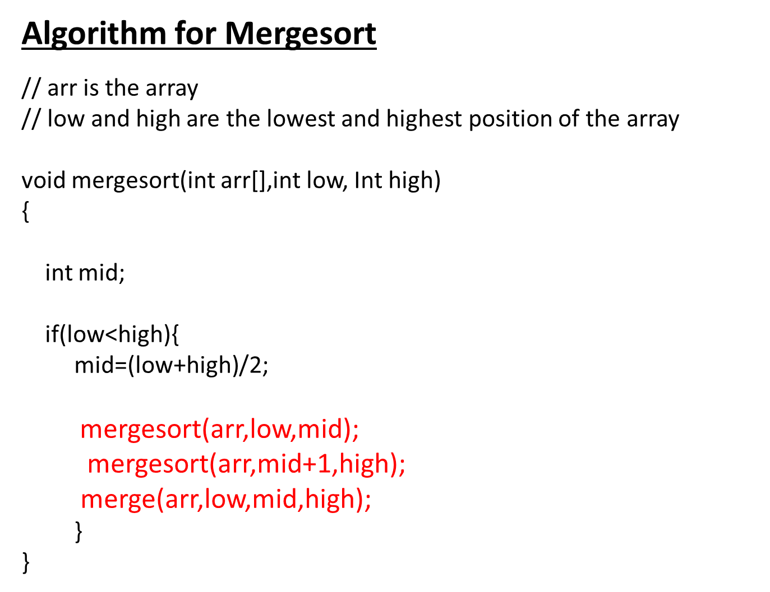

Slide 17
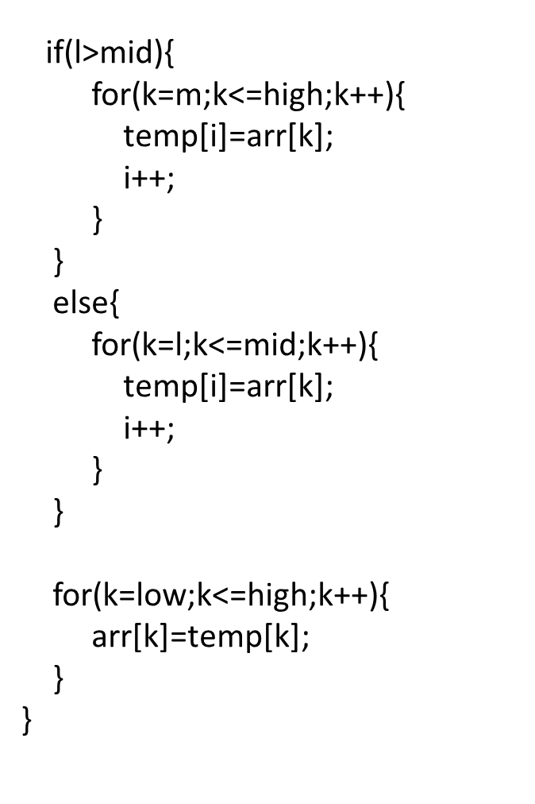
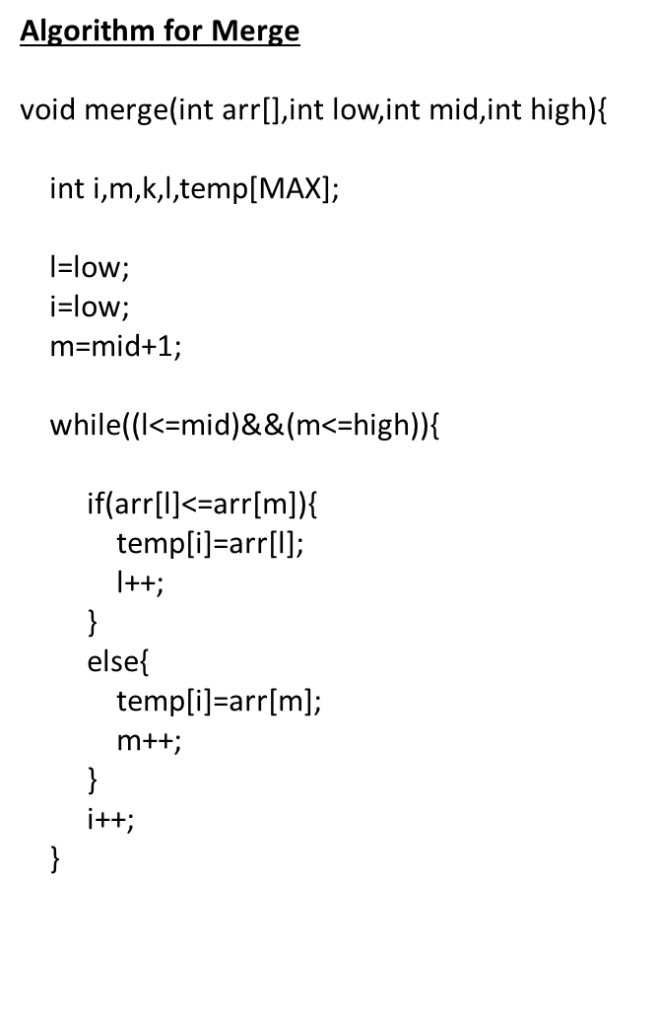

Slide 18
Quicksort Algorithm
Given an array of n elements (e.g., integers):
If array only contains one element, return
Else
  pick one element to use as pivot.
  Partition elements into two sub-arrays:
    Elements less than or equal to pivot
    Elements greater than pivot
  Quicksort two sub-arrays
  Return results

Slide 19
Example
We are given array of n integers to sort:
40
20
10
80
60
50
7
30
100

Slide 20
Pick Pivot Element
There are a number of ways to pick the pivot element. In this example, we will use the first element in the array:
40
20
10
80
60
50
7
30
100

Slide 21
Partitioning Array
Given a pivot, partition the elements of the array such that the resulting array consists of:
  One sub-array that contains elements >= pivot
  Another sub-array that contains elements < pivot
The sub-arrays are stored in the original data array.
Partitioning loops through, swapping elements below/above pivot.

Slide 22
pivot_index = 0
40
20
10
80
60
50
7
30
100
[0] [1] [2] [3] [4] [5] [6] [7] [8]
too_big_index
too_small_index

Slide 23
While data[too_big_index] <= data[pivot]
++too_big_index
pivot_index = 0
40
20
10
80
60
50
7
30
100
[0] [1] [2] [3] [4] [5] [6] [7] [8]
too_big_index
too_small_index

Slide 24
While data[too_big_index] <= data[pivot]
++too_big_index
pivot_index = 0
40
20
10
80
60
50
7
30
100
[0] [1] [2] [3] [4] [5] [6] [7] [8]
too_big_index
too_small_index

Slide 25
While data[too_big_index] <= data[pivot]
++too_big_index
pivot_index = 0
40
20
10
80
60
50
7
30
100
[0] [1] [2] [3] [4] [5] [6] [7] [8]
too_big_index
too_small_index

Slide 26
While data[too_big_index] <= data[pivot]
  ++too_big_index
While data[too_small_index] > data[pivot]
  --too_small_index
pivot_index = 0
40
20
10
80
60
50
7
30
100
[0] [1] [2] [3] [4] [5] [6] [7] [8]
too_big_index
too_small_index

Slide 27
While data[too_big_index] <= data[pivot]
  ++too_big_index
While data[too_small_index] > data[pivot]
  --too_small_index
pivot_index = 0
40
20
10
80
60
50
7
30
100
[0] [1] [2] [3] [4] [5] [6] [7] [8]
too_big_index
too_small_index

Slide 28
While data[too_big_index] <= data[pivot]
  ++too_big_index
While data[too_small_index] > data[pivot]
  --too_small_index
If too_big_index < too_small_index
  swap data[too_big_index] and data[too_small_index]
pivot_index = 0
40
20
10
80
60
50
7
30
100
[0] [1] [2] [3] [4] [5] [6] [7] [8]
too_big_index
too_small_index

Slide 29
While data[too_big_index] <= data[pivot]
  ++too_big_index
While data[too_small_index] > data[pivot]
  --too_small_index
If too_big_index < too_small_index
  swap data[too_big_index] and data[too_small_index]
pivot_index = 0
40
20
10
30
60
50
7
80
100
[0] [1] [2] [3] [4] [5] [6] [7] [8]
too_big_index
too_small_index

Slide 30
While data[too_big_index] <= data[pivot]
  ++too_big_index
While data[too_small_index] > data[pivot]
  --too_small_index
If too_big_index < too_small_index
  swap data[too_big_index] and data[too_small_index]
While too_small_index > too_big_index, go to 1.
pivot_index = 0
40
20
10
30
60
50
7
80
100
[0] [1] [2] [3] [4] [5] [6] [7] [8]
too_big_index
too_small_index

Slide 31
While data[too_big_index] <= data[pivot]
  ++too_big_index
While data[too_small_index] > data[pivot]
  --too_small_index
If too_big_index < too_small_index
  swap data[too_big_index] and data[too_small_index]
While too_small_index > too_big_index, go to 1.
pivot_index = 0
40
20
10
30
60
50
7
80
100
[0] [1] [2] [3] [4] [5] [6] [7] [8]
too_big_index
too_small_index

Slide 32
While data[too_big_index] <= data[pivot]
  ++too_big_index
While data[too_small_index] > data[pivot]
  --too_small_index
If too_big_index < too_small_index
  swap data[too_big_index] and data[too_small_index]
While too_small_index > too_big_index, go to 1.
pivot_index = 0
40
20
10
30
60
50
7
80
100
[0] [1] [2] [3] [4] [5] [6] [7] [8]
too_big_index
too_small_index

Slide 33
While data[too_big_index] <= data[pivot]
  ++too_big_index
While data[too_small_index] > data[pivot]
  --too_small_index
If too_big_index < too_small_index
  swap data[too_big_index] and data[too_small_index]
While too_small_index > too_big_index, go to 1.
pivot_index = 0
40
20
10
30
60
50
7
80
100
[0] [1] [2] [3] [4] [5] [6] [7] [8]
too_big_index
too_small_index

Slide 34
While data[too_big_index] <= data[pivot]
  ++too_big_index
While data[too_small_index] > data[pivot]
  --too_small_index
If too_big_index < too_small_index
  swap data[too_big_index] and data[too_small_index]
While too_small_index > too_big_index, go to 1.
pivot_index = 0
40
20
10
30
60
50
7
80
100
[0] [1] [2] [3] [4] [5] [6] [7] [8]
too_big_index
too_small_index

Slide 35
While data[too_big_index] <= data[pivot]
  ++too_big_index
While data[too_small_index] > data[pivot]
  --too_small_index
If too_big_index < too_small_index
  swap data[too_big_index] and data[too_small_index]
While too_small_index > too_big_index, go to 1.
pivot_index = 0
40
20
10
30
60
50
7
80
100
[0] [1] [2] [3] [4] [5] [6] [7] [8]
too_big_index
too_small_index

Slide 36
While data[too_big_index] <= data[pivot]
  ++too_big_index
While data[too_small_index] > data[pivot]
  --too_small_index
If too_big_index < too_small_index
  swap data[too_big_index] and data[too_small_index]
While too_small_index > too_big_index, go to 1.
pivot_index = 0
40
20
10
30
7
50
60
80
100
[0] [1] [2] [3] [4] [5] [6] [7] [8]
too_big_index
too_small_index

Slide 37
While data[too_big_index] <= data[pivot]
  ++too_big_index
While data[too_small_index] > data[pivot]
  --too_small_index
If too_big_index < too_small_index
  swap data[too_big_index] and data[too_small_index]
While too_small_index > too_big_index, go to 1.
pivot_index = 0
40
20
10
30
7
50
60
80
100
[0] [1] [2] [3] [4] [5] [6] [7] [8]
too_big_index
too_small_index

Slide 38
While data[too_big_index] <= data[pivot]
  ++too_big_index
While data[too_small_index] > data[pivot]
  --too_small_index
If too_big_index < too_small_index
  swap data[too_big_index] and data[too_small_index]
While too_small_index > too_big_index, go to 1.
pivot_index = 0
40
20
10
30
7
50
60
80
100
[0] [1] [2] [3] [4] [5] [6] [7] [8]
too_big_index
too_small_index

Slide 39
While data[too_big_index] <= data[pivot]
  ++too_big_index
While data[too_small_index] > data[pivot]
  --too_small_index
If too_big_index < too_small_index
  swap data[too_big_index] and data[too_small_index]
While too_small_index > too_big_index, go to 1.
pivot_index = 0
40
20
10
30
7
50
60
80
100
[0] [1] [2] [3] [4] [5] [6] [7] [8]
too_big_index
too_small_index

Slide 40
While data[too_big_index] <= data[pivot]
  ++too_big_index
While data[too_small_index] > data[pivot]
  --too_small_index
If too_big_index < too_small_index
  swap data[too_big_index] and data[too_small_index]
While too_small_index > too_big_index, go to 1.
pivot_index = 0
40
20
10
30
7
50
60
80
100
[0] [1] [2] [3] [4] [5] [6] [7] [8]
too_big_index
too_small_index

Slide 41
While data[too_big_index] <= data[pivot]
  ++too_big_index
While data[too_small_index] > data[pivot]
  --too_small_index
If too_big_index < too_small_index
  swap data[too_big_index] and data[too_small_index]
While too_small_index > too_big_index, go to 1.
pivot_index = 0
40
20
10
30
7
50
60
80
100
[0] [1] [2] [3] [4] [5] [6] [7] [8]
too_big_index
too_small_index

Slide 42
While data[too_big_index] <= data[pivot]
  ++too_big_index
While data[too_small_index] > data[pivot]
  --too_small_index
If too_big_index < too_small_index
  swap data[too_big_index] and data[too_small_index]
While too_small_index > too_big_index, go to 1.
pivot_index = 0
40
20
10
30
7
50
60
80
100
[0] [1] [2] [3] [4] [5] [6] [7] [8]
too_big_index
too_small_index

Slide 43
While data[too_big_index] <= data[pivot]
  ++too_big_index
While data[too_small_index] > data[pivot]
  --too_small_index
If too_big_index < too_small_index
  swap data[too_big_index] and data[too_small_index]
While too_small_index > too_big_index, go to 1.
pivot_index = 0
40
20
10
30
7
50
60
80
100
[0] [1] [2] [3] [4] [5] [6] [7] [8]
too_big_index
too_small_index

Slide 44
While data[too_big_index] <= data[pivot]
  ++too_big_index
While data[too_small_index] > data[pivot]
  --too_small_index
If too_big_index < too_small_index
  swap data[too_big_index] and data[too_small_index]
While too_small_index > too_big_index, go to 1.
pivot_index = 0
40
20
10
30
7
50
60
80
100
[0] [1] [2] [3] [4] [5] [6] [7] [8]
too_big_index
too_small_index

Slide 45
While data[too_big_index] <= data[pivot]
  ++too_big_index
While data[too_small_index] > data[pivot]
  --too_small_index
If too_big_index < too_small_index
  swap data[too_big_index] and data[too_small_index]
While too_small_index > too_big_index, go to 1.
Swap data[too_small_index] and data[pivot_index]
pivot_index = 0
40
20
10
30
7
50
60
80
100
[0] [1] [2] [3] [4] [5] [6] [7] [8]
too_big_index
too_small_index

Slide 46
While data[too_big_index] <= data[pivot]
  ++too_big_index
While data[too_small_index] > data[pivot]
  --too_small_index
If too_big_index < too_small_index
  swap data[too_big_index] and data[too_small_index]
While too_small_index > too_big_index, go to 1.
Swap data[too_small_index] and data[pivot_index]
7
20
10
30
40
50
60
80
100
pivot_index = 4
[0] [1] [2] [3] [4] [5] [6] [7] [8]
too_big_index
too_small_index

Slide 47
Partition Result
7
20
10
30
40
50
60
80
100
[0] [1] [2] [3] [4] [5] [6] [7] [8]
<= data[pivot]
> data[pivot]

Slide 48
Recursion: Quicksort Sub-arrays
7
20
10
30
40
50
60
80
100
[0] [1] [2] [3] [4] [5] [6] [7] [8]
<= data[pivot]
> data[pivot]

Slide 49
Sample Algorithm
Algorithm quick_sort ( int A[ ] ,int start , int end )
{
if( start < end )
{
//stores the position of pivot element
int piv_pos = partition (A,start , end ) ;
quick_sort (A,start , piv_pos -1); //sorts the left side of pivot.
quick_sort ( A,piv_pos +1 , end) ; //sorts the right side of pivot.
}
}

Slide 50
Algorithm partition ( int A[],int start ,int end)
{
int i = start + 1;
int piv = A[start] ; //make the first element as pivot element.
for(int j =start + 1; j <= end ; j++ ) {
/*rearrange the array by putting elements which are less than pivot
on one side and which are greater that on other. */
if ( A[ j ] < piv) {
swap (A[ i ],A [ j ]);
i += 1;
}
}
swap ( A[ start ] ,A[ i-1 ] ) ; //put the pivot element in its proper place.
return i-1; //return the position of the pivot
}

